Slide 1
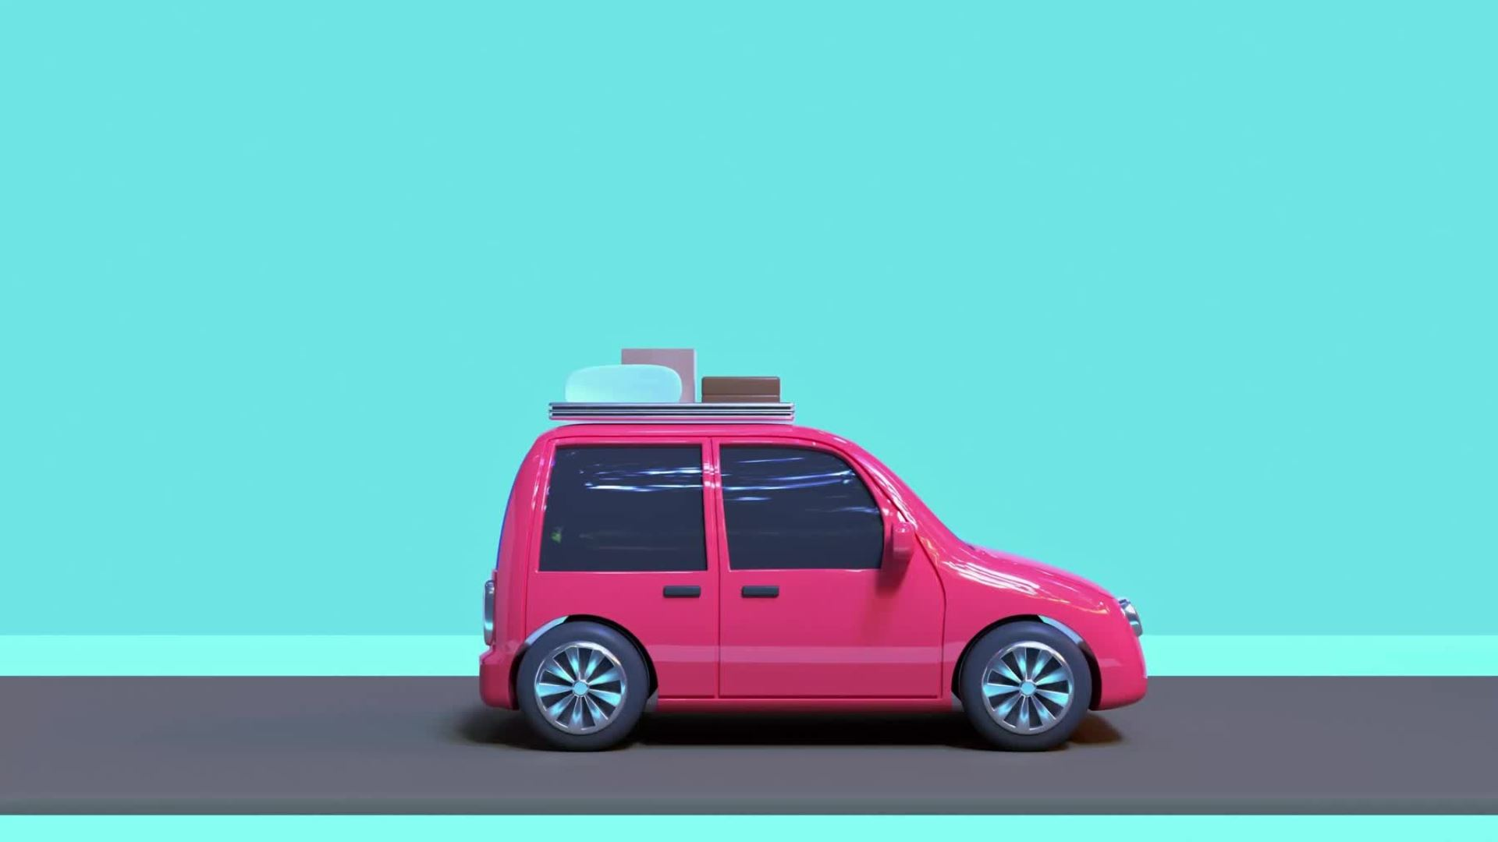
Traditional Vehicles Vs Modern Vehicles
Task 11 Forces and Vehicle Safety

Slide 2
Principle A - Crumple Zones
Crumple Zones are a section of an automobile body designed to absorb the force of an impact in order to protect the passengers. They absorb energy by the crumpling, and slow down the collision which reduces the change in momentum.
Cars manufactured before the 60s do not have these crumple zones until the introduction of the Mercedes Benz 220 in 1959. Cars older than this tend to be more dangerous, especially in a crash.

Slide 3
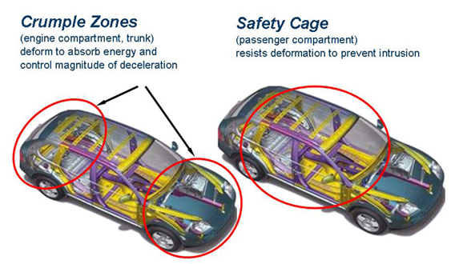
Principle B – Crumple Zones
Modern vehicles nowadays have crumple zones which are designed in a way to have controlled collisions. They increase the time taken to change the momentum of the driver and passengers in a crash, which reduces the force involved.

Slide 4
Principle C - Suspension
The suspension system has a lot to do with controlling your vehicle. It is not just for comfort but assists the vehicle to handle the road. A problem with the suspension system can lead to serious accidents, putting the driver and passengers at risk of injury or death.
Without suspension systems, cars wouldn’t be stable to drive on especially bumpy roads or offroad as they use springs to lower a cars centre of gravity which are important in a cars stability in when driving very fast.

Slide 5
Principle D - Airbags
A bag that is inflated with air typically for use as a cushion or safety device especially such a bag installed in an automobile as a safety device designed to inflate automatically in case of collision.
Airbags follow Newtons 2nd Law as its momentum continues until an outside force (such as the steering wheel, dashboard or windshield) brings it to a stop. An airbag doesn't just soften the blow. It lowers the impact by stretching it out over a longer period.

Slide 6
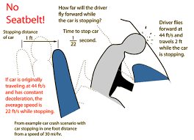
Principle E – Seatbelts
Seatbelts are an arrangement of straps designed to hold a person steady in a seat such as in an airplane or automobile. Seat belts attach your body mass to that of a car, meaning that when the car accelerates or decelerates, you do also. Were it not for seatbelts, your body would be acted upon by Newton's First Law independently of the vehicle. The inertia keeps the bodies moving simultaneously until the seat belts stop their motion

Slide 7
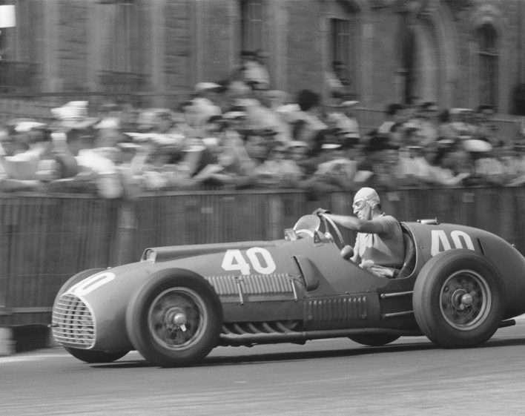
1950 Classic F1 Vehicle
Formula One (also known as Formula 1 or F1) is the highest class of international racing for open-wheel single-seater formula racing cars sanctioned by the Federation International de L'Automobile (FIA).
Back at the dawn of the championship in 1950, drivers wore cloth caps paired with goggles, which did little other than protect them from dirt and insects before cork helmets became mandatory in 1952.

Slide 8
Unsafety Features of Classic F1 Vehicles
Principle A: The cars of the 1950s had steel and aluminum tube frames compared to modern carbon fibre monocoques. In terms of aerodynamics, the cars of the 1950s were only built for low drag while drag is a secondary concern to producing downforce on the current cars.
Principle E: In the 1950s, there was no consideration for safety in the regulations. Seatbelts existed but were often not used as drivers felt it better to be thrown from bigger crashes. Fuel was kept in metal tanks often running along the sides of the car and, in the case of races requiring more fuel, even in the cockpit. Modern cars use a puncture proof flexible fuel cell that is buried in the tub between the cockpit and the engine to avoid being damaged in an accident. Crash structures, meaningful rollover protection, and fire extinguishers were nonexistent.
Principle C: Car Suspension was very limited as the wheels would not adjust to surfaces making the stability of the vehicle very stiff can hard to turn.

Slide 9
Vehicle Safety Features
Vehicle safety features can significantly improve safety and are becoming more widely available. Technologies like autonomous emergency braking , blind-spot monitoring and lane-support systems can reduce the risk of a crash. Side curtain airbags can reduce the severity of an injury if a crash cannot be avoided.
Driver and passenger airbags typically will deploy if you get into an accident that involves the front of your vehicle. However, some cars come equipped with several additional airbags. The supplemental airbags can help protect you in many different circumstances or accident types. The additional airbags include side curtain airbags, knee airbags, and inflatable seat belts.
This safety feature helps to track the location of the vehicle within the painted lines of the road. If the turn signal hasn’t been turned on and the car begins to near either side of the lane, a beep, vibration, or visual indication can let a driver know that they are veering into another lane. Lane keep assist makes minor adjustments to the steering to help keep the vehicle in its lane.

Slide 10
Safety Features Using Physics
Seatbelts
Seat belts attach your body mass to that of a car, meaning that when the car accelerates or decelerates, you do also. Were it not for seatbelts, your body would be acted upon by Newton's First Law independently of the vehicle. If the car came to an abrupt halt after travelling at constant velocity (for example, in a motor vehicle accident) and the passenger was not wearing a seatbelt, they would continue travelling at constant velocity, probably resulting in a collision with the windscreen or the back of the seat in front of them.
Headrest
If a car is stationary and it is acted upon by an unbalanced force in a rear impact, it would move quickly forward. If a passenger is wearing a seatbelt, their torso is moved rapidly forward with the car, leaving their head behind and making it bend backwards quickly enough to cause injury. This happens because if a mass (the head) is stationary, Newton's First Law states that it will stay this way until it is acted upon by an unbalanced force. If there is a properly adjusted headrest, the head will be moved forward at the same time and rate as the torso, meaning that the neck does not have to bend uncomfortably. Headrests also provide a small amount of protection from anything thrown forward if the car were to stop suddenly.

Slide 11
Safety Features Using Physics
Crumple Zones
If the vehicle comes to a sudden stop, then the bodies inside the vehicle keep travelling forward according to Newton's First Law (an object travelling at a constant velocity will remain at a constant velocity until acted upon by an unbalanced force). They will travel forward and apply force to the first thing they encounter- hopefully a seatbelt and/or airbag, which will apply identical and opposite force back on them according to Newton's Third Law. If the body decelerates before coming to a sudden stop, such as in the case of a car with Crumple Zones, they are travelling a little slower when they run into whatever is in their path, meaning that they exert less Force and less Force is exerted on them.

